Slide 1

HeartyBeat
Made by:
Gergana Bineva and Kristiana Stojkova

Slide 2
Content:
01
Hearty-beat
02
development
03
Tools used
04
Our app
What is our project about?
What were the stages of developing our project?
What tools we used to develop our project?
Let's go see our app!!

Slide 3
OUR PROJECT
OUR PROJECT
Let's talk about our project.
Arduino Scheme
WebApp

Slide 4
Stages of development
 | Geri | Krisi
DESIGN | Created Logo and uploaded the logos for the README.md. Created the WebApp layout design. | Drew the resources for the WebApp.
CODE | Created the WebApp. | Wrote the code for the Arduino.
ARDUINO | Made design for the Arduino. | Connected the Arduino system.
PRESENTATION | Created Documentation and Charts. Created a Wiki page. | Created Presentation and README.md

Slide 5



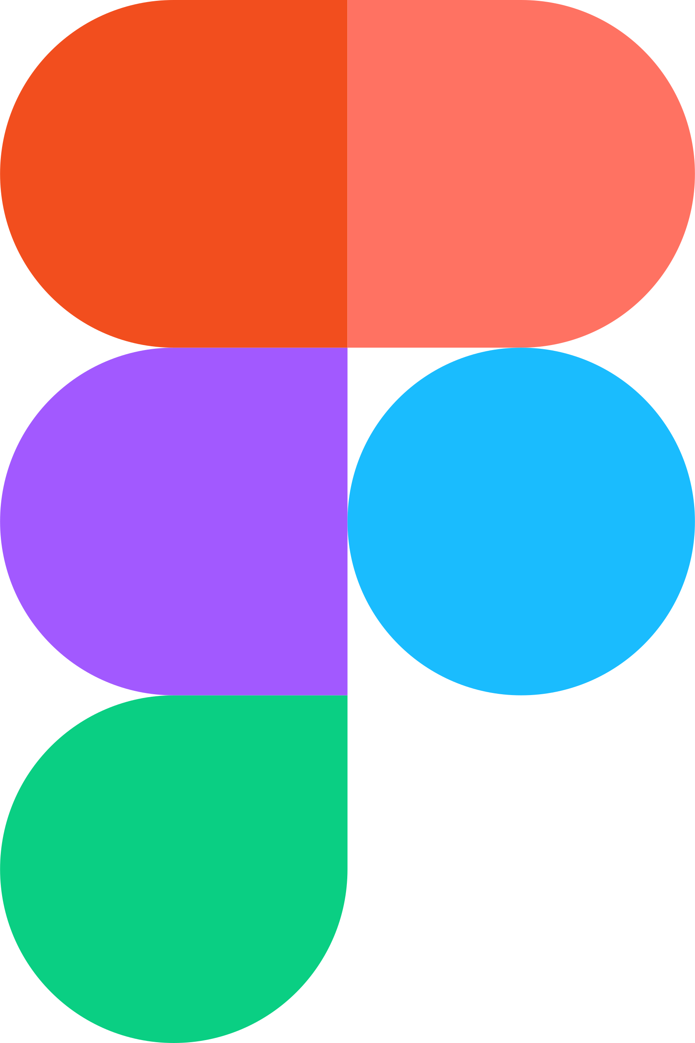









Tools used:
IDE
Language tools
Design
arduino
Documentation
schemes

Slide 6
Go to project!
GO to project!

Slide 7

THanks
THanks
THank you for your attention!!
Conserva esta diapositiva para atribuirnos

